Slide 1
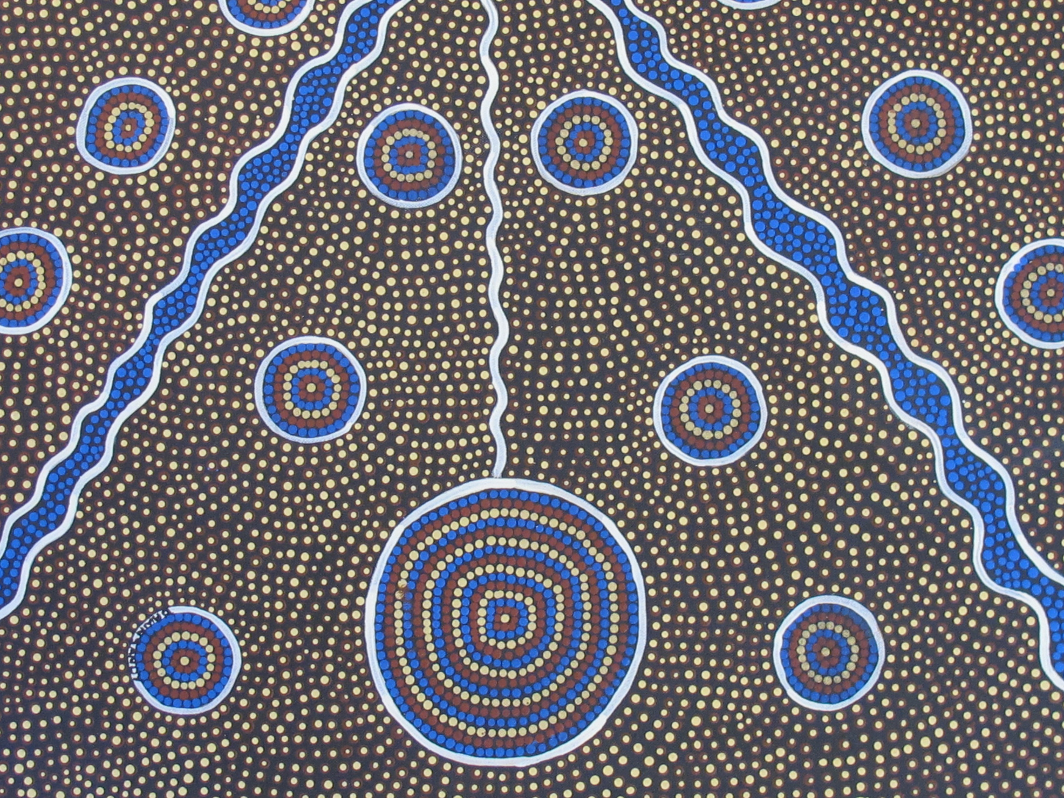
Acknowledgement of Country

Slide 2
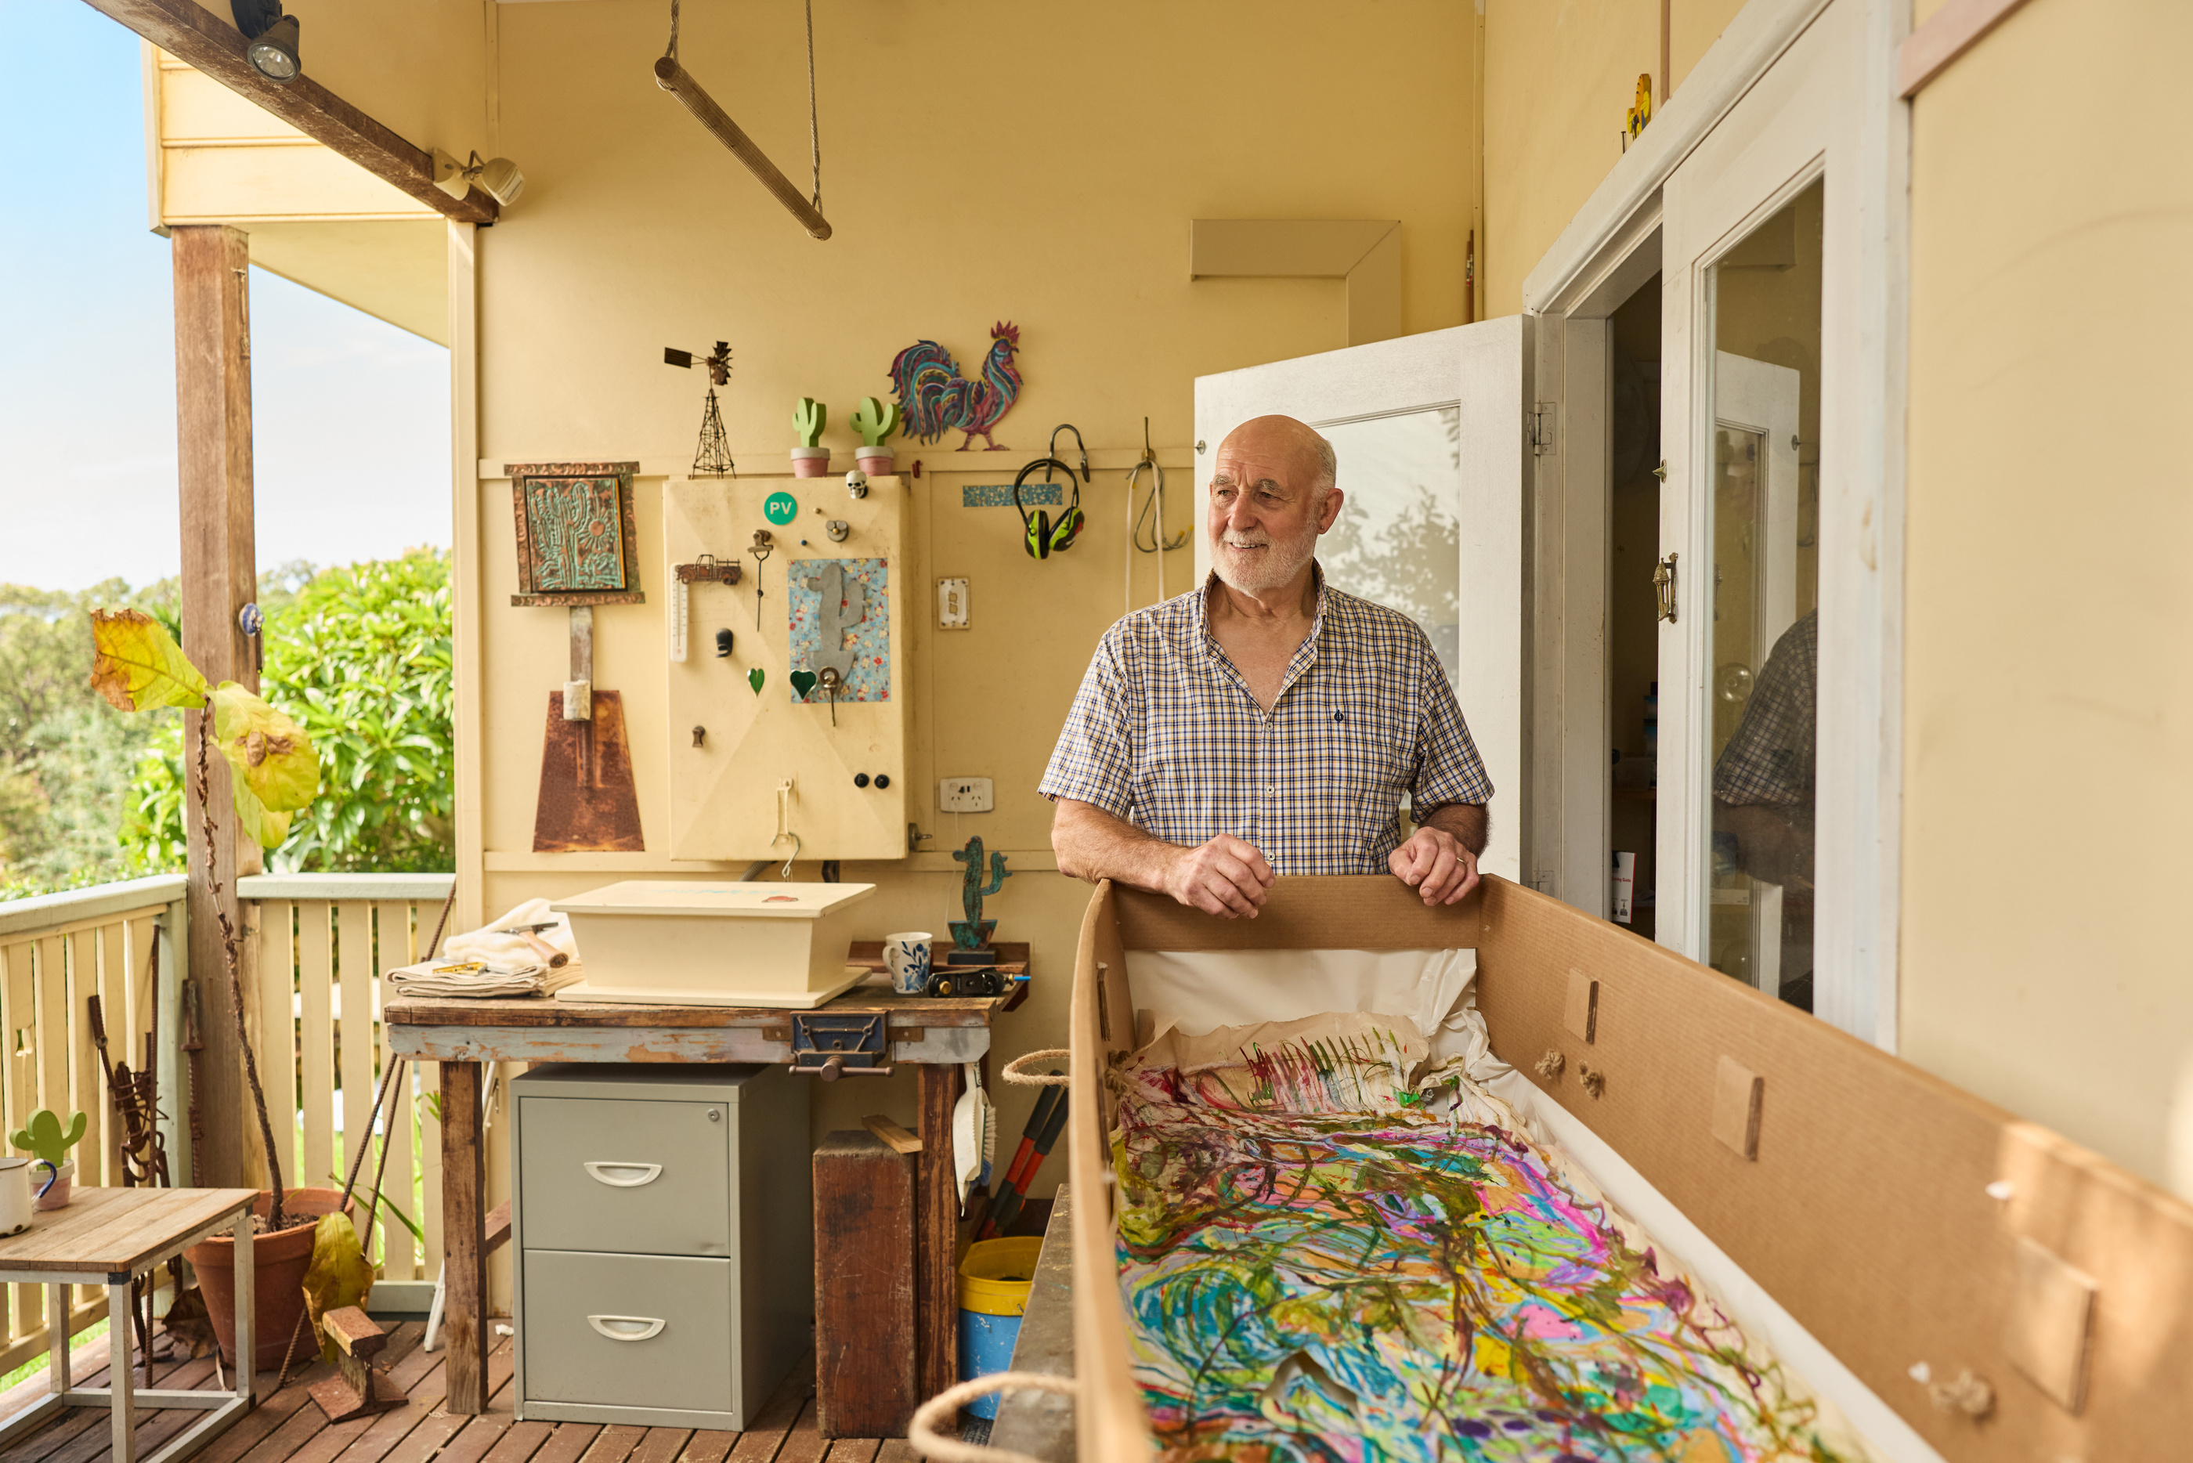



The secret I’m glad I shared.

Slide 3

We’re not here to whisper about death. We’re here to yell about life.
Dying to Know is a national campaign that encourages people to prepare for the inevitable with purpose, care and a clear sense of legacy.
In 2026, our campaign Nobody Knows continues to shift the conversation. Because these moments are not formal or planned. They happen in real life. On a road trip. At a BBQ. Between errands. In the small, ordinary moments shared with the people who matter most.
When things go unsaid, nobody knows what matters to us in the end. That uncertainty can create confusion, stress and missed opportunities for connection.
The “Secret I’m Glad” I Shared shines a light on the relief, humour and closeness that comes from saying something out loud before it is too late.
This year, we are encouraging people to lean into the moments that already exist. To start the conversation in their own way. To create space across generations to share what matters, however it is said.
Because when we talk about it, we make it easier for everyone.

Slide 4
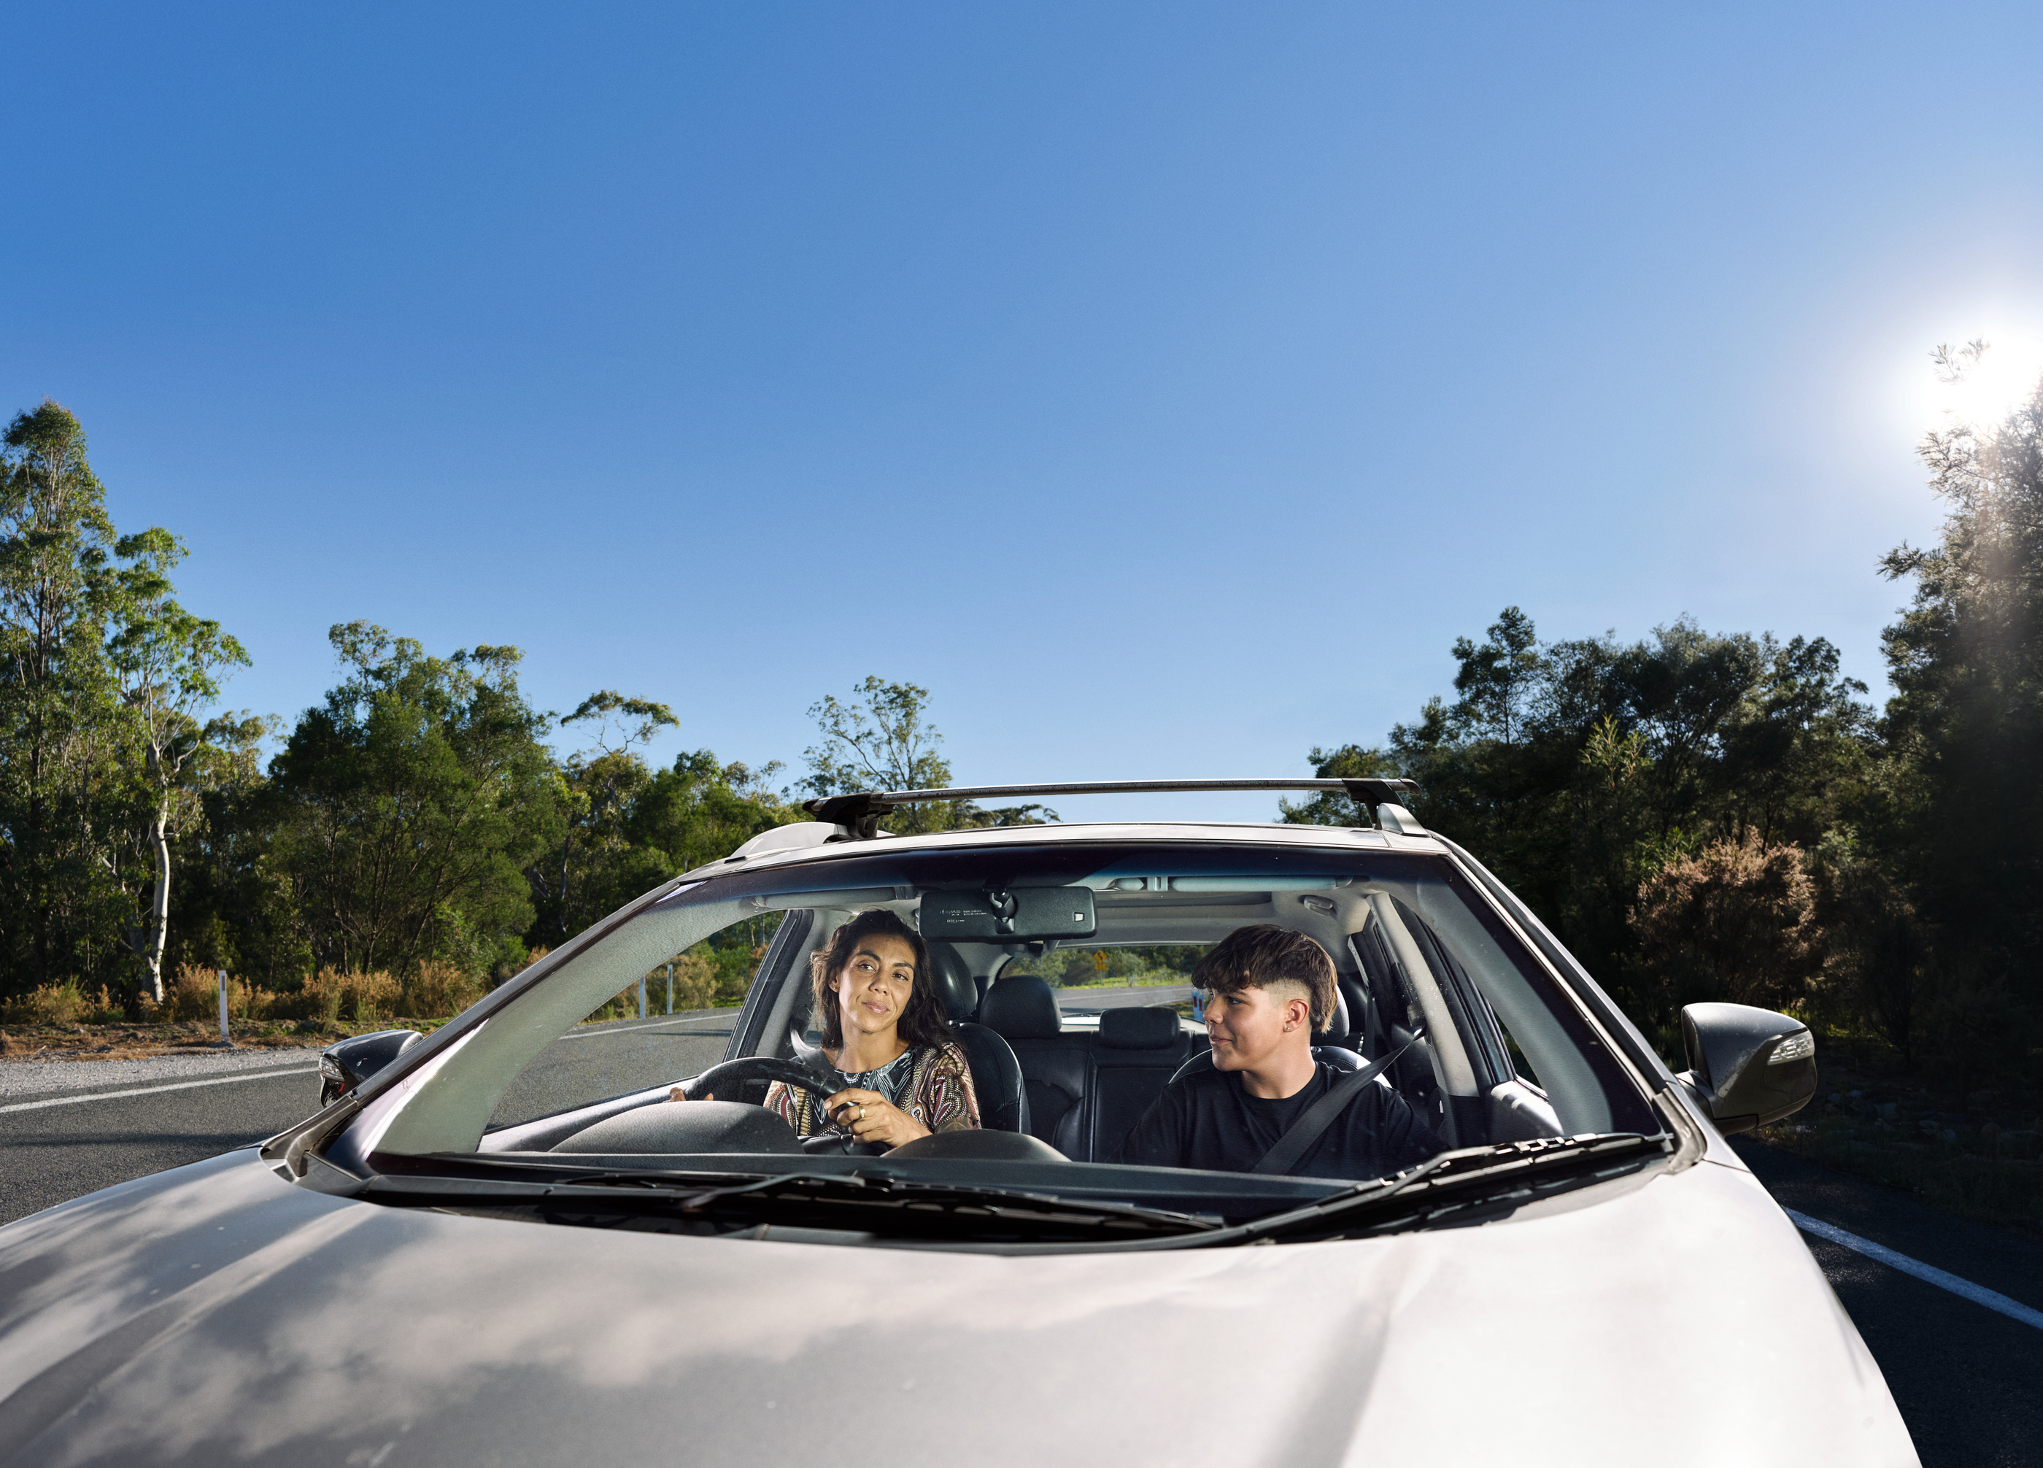
The secret I’m glad I shared.

Slide 5
HEADING
FONT:
ROBOTO SLAB

Slide 6
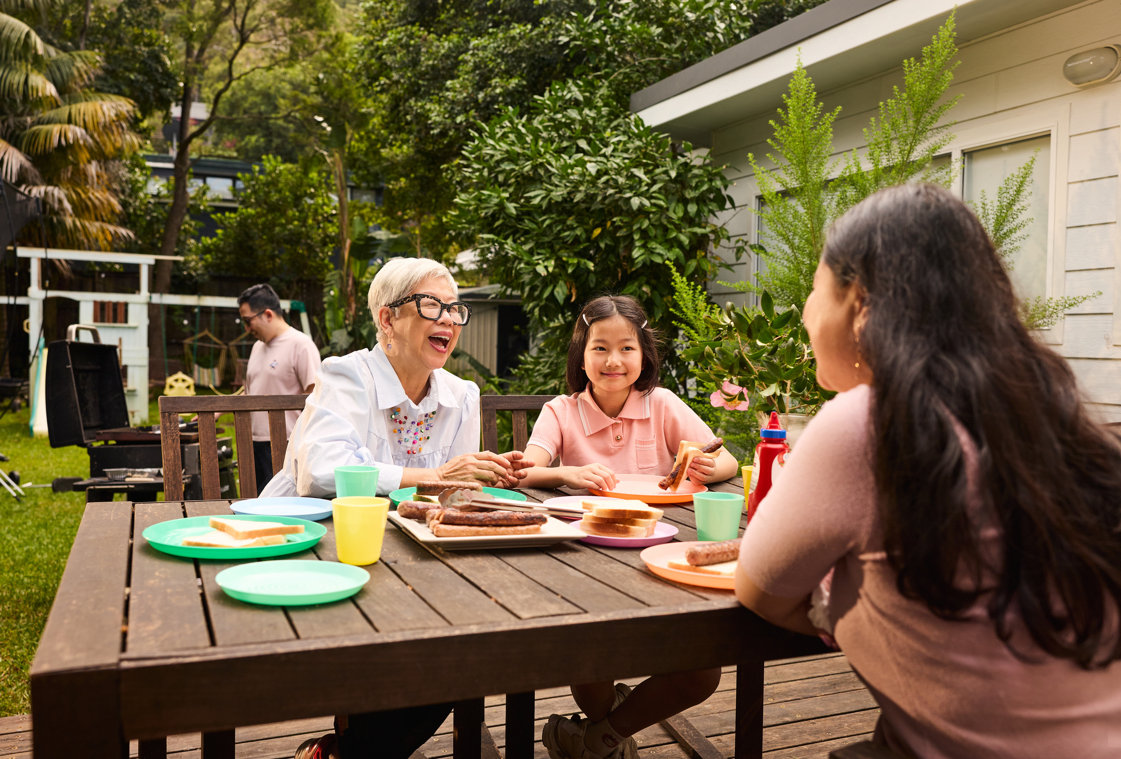
The secret I’m glad I shared.

Slide 7
HEADING
FONT:
ROBOTO SLAB

Slide 8
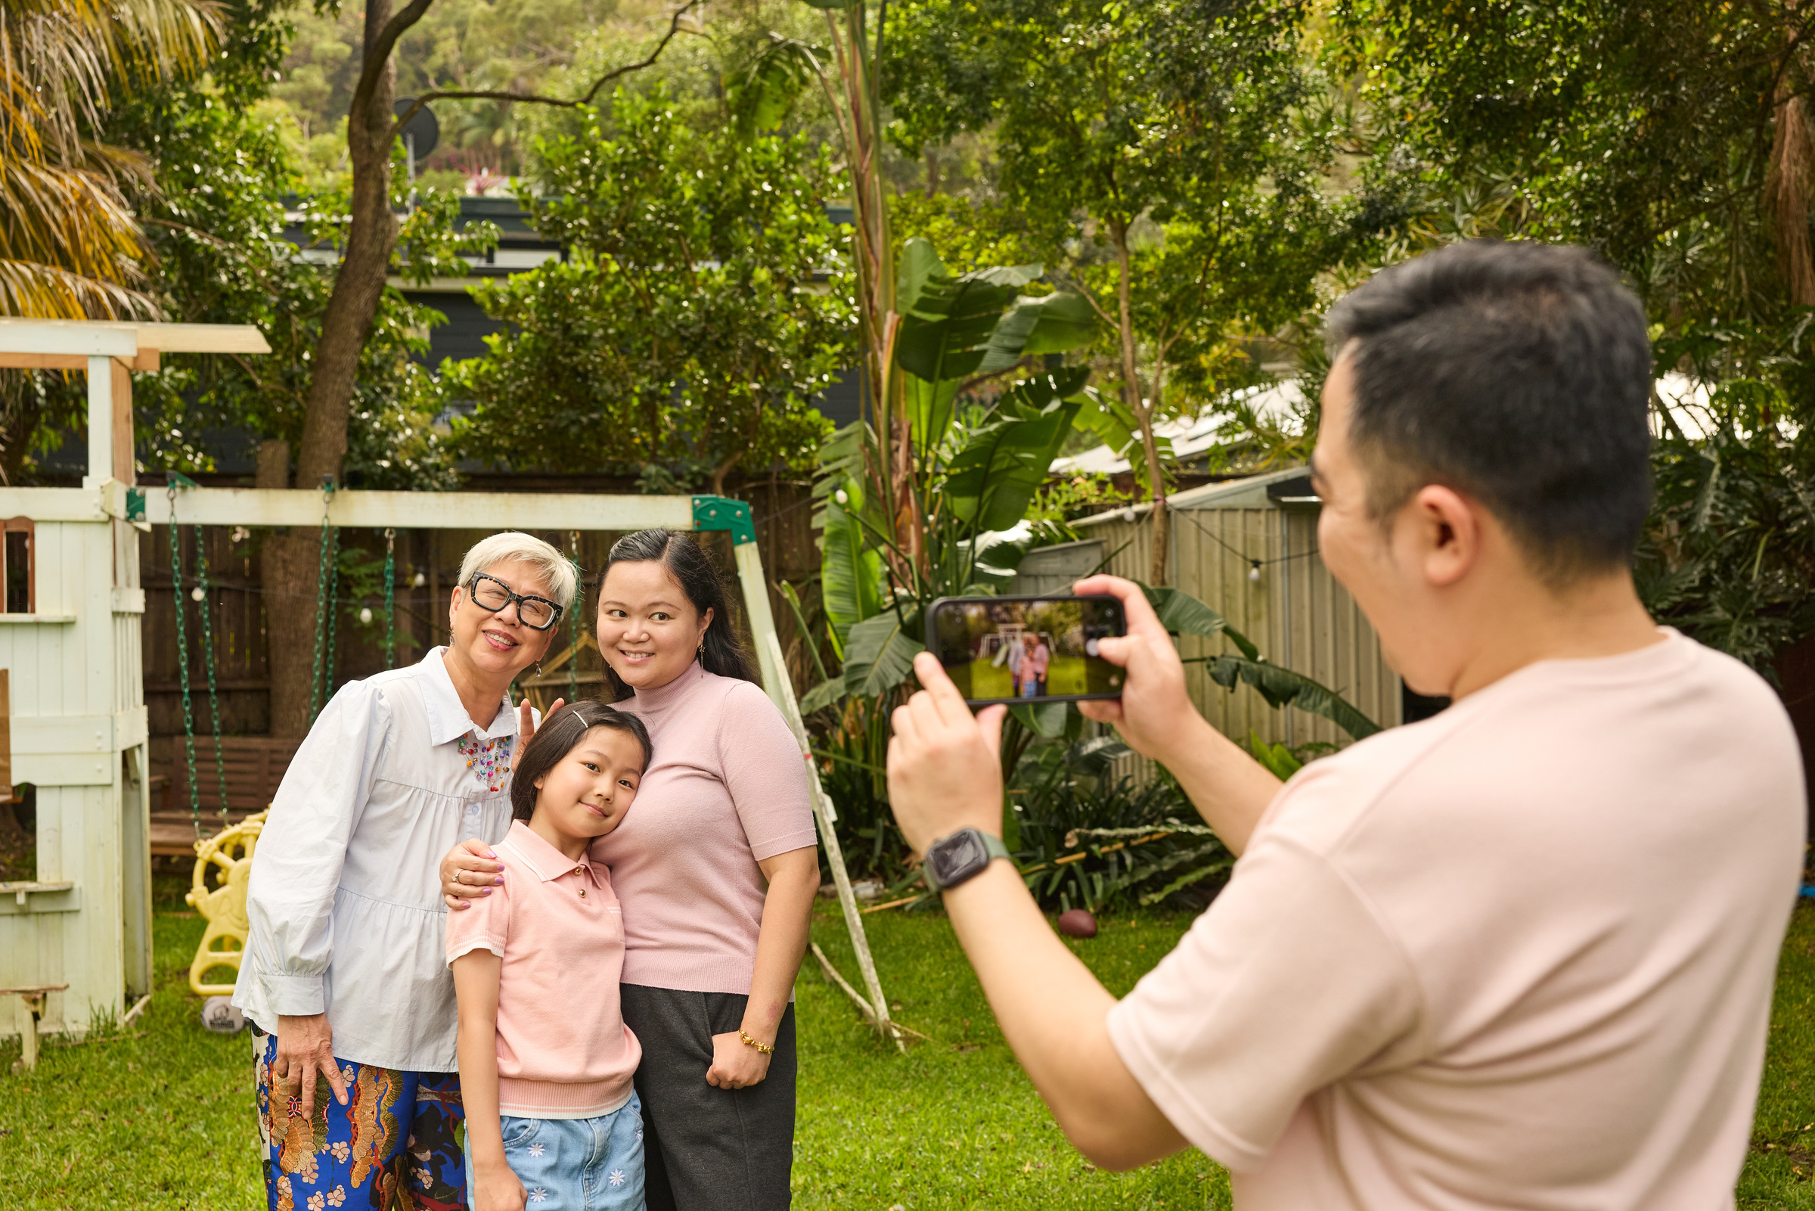

Slide 9
HEADING
FONT:
ROBOTO SLAB

Slide 10

Powered by

